Slide 1
Java SE Developer
1z0-819
講師:江聖榮

Slide 2
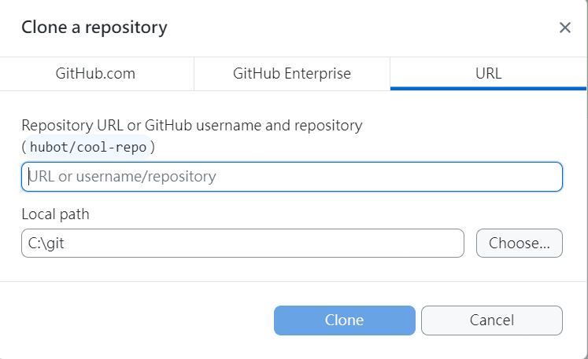
GitHub
本地端主機
  新增資料夾
GitHub網站
New
  Create a new repository
  Repository name
  Description
  Add readme file
GitHub desktop
Clone a repository
URL

Slide 3
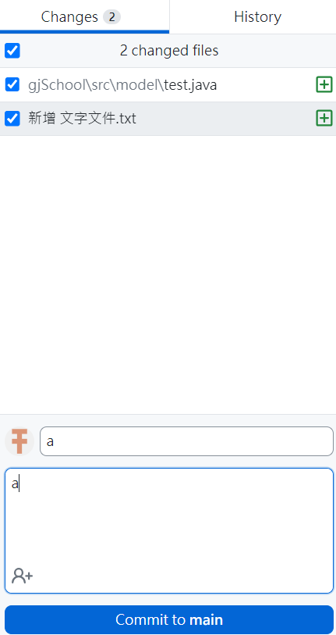

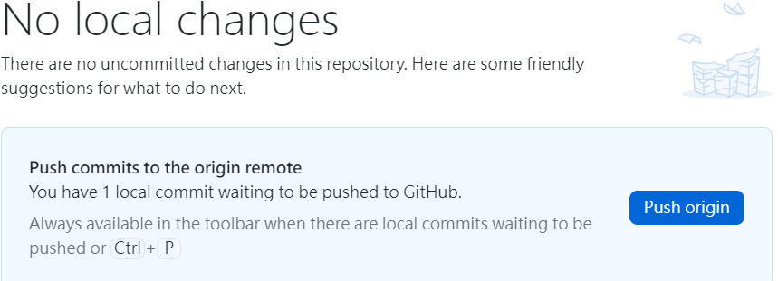
Git hub DeskTop

Slide 4
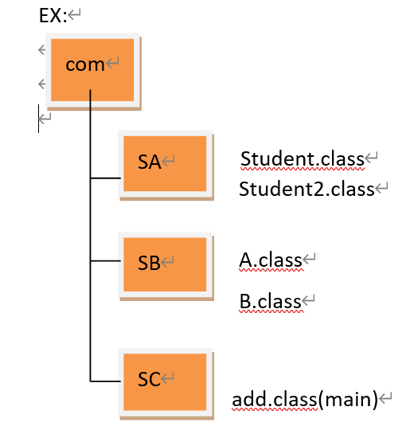
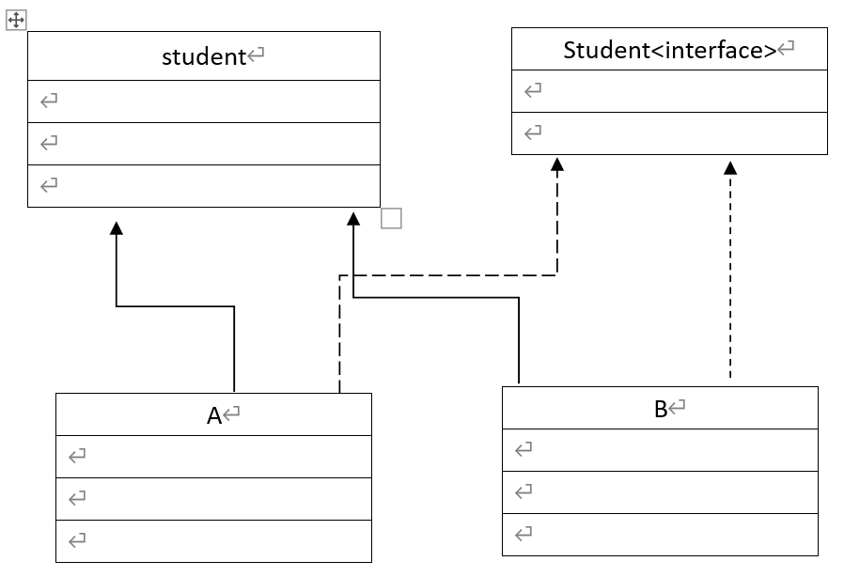
package,encapsulation
Package
  import
Encapsulation
  Public
  Protected
  <default>
  private

Slide 5
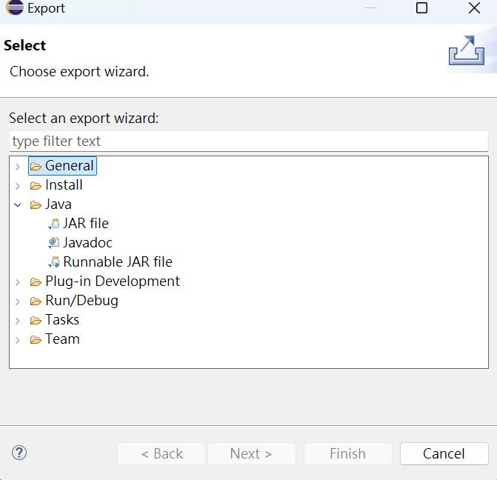
Jar , javaDoc
JAR file
JavaDoc
  /**
  */
  @version
  @author
  @param

